Slide 1

Diversity Month 2025: wrap up & D&I Group roadmap project 2026
HR Dev Co
12 December 2025

Slide 2

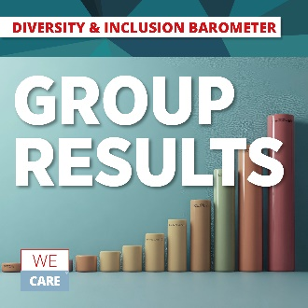
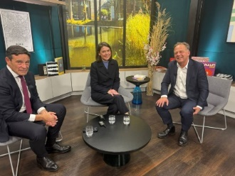
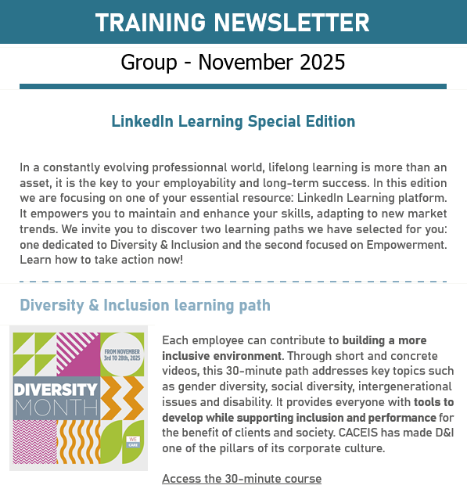


Diversity Month overview at a group level
Diversity Month 2025 – Wrap up
D&I barometer group results
Presentation to: Comex (3.11), CMD committee (19.11)
Infographic with main insights on OMNIA (20.11)
In France: presentation to the Works Council (27.11), Town Hall (16.12)
Conference on equal opportunities at the heart of our talent development organised by CAsa
With Bruno BOURBONNAUD (Global Head of Market Solutions - CACEIS) and Etienne EPITALION (Head of HR – CAPFM)
D&I: raising awareness
A LinkedIn Learning training path dedicated to D&I (FR& EN)
Podcast Rise Together launched by Deepika Lyer:
Episode 3: Strength from our differences with Riadh Gasmi, IT – Head of Unit and Paula Martin Gutierrez, Client Project Coordinator, about what diversity and inclusion means in practice at CACEIS.

Slide 3





Diversity Month: local initiatives (1/4)
Diversity Month 2025 – Wrap up
Belgium
Conference of Charles Pépin ; Boldness: learning to dare & acting in uncertainty
Conference of United Fund For Belgium: association helping people in need
Collect of clothes for association "La Fontaine" to help people in need
Canada:
Taste of Cultures: Diversity Month Potluck
Proudly Wear your Culture Day
France:
Intergenerational: a shadow local executive committee with young employees, the “next Gen Squad”
Webinars : Gender Diversity / Neurodiversities
All month long: assignements on equal opportunities on the volunteering platform “J’agis”
Germany
Ireland:
Afternoon Tea - Come together with colleagues for a cup of tea/coffee and a treat.
Creating an Inclusive Culture Training and learn about our different generations in the workplace by building more inclusive behaviours and practices in our everyday work.
Financial Wellbeing Mastercall - All generations should prepare their future and financial wellness
International Men’s Day - Join us for a Webinar
Celebrating Black Month History - Videos
Osteoporosis Awareness

Slide 4




Diversity Month: local initiatives (2/4)
Diversity Month 2025 – Wrap up
Italy:
Webinar “ Art and Inclusion” in collaboration with other CA Italia entities: How arts can help inclusion…Gender Diversity
Intergenerational initiatives:
3 training focus groups on Intergenerational differences
Reverse mentoring
GREAT event with other local networks
Solidarity : Collection of food for Banco Alimentare
Luxemburg:
Let's Play Equal: collaborative board game that moves the lines on equality through challenges, discussions and fun situations.
Each participant plays a fictional character and is confronted with mechanisms of exclusion, privileges and discrimination throughout the course. The goal is to share in a group the feelings, perceived injustices and their parallels with reality.
4 dialogues shared on OMNIA on intergenerational
Malaysia
Malaysian Cultural Program - for all Expat employees working in
Malaysia#MenToo - Time Capsule
Hear Me Out (Female employee sharing session facilitated by leaders)
The Power of Vulnerability
Advocacy Vs. Humility
Netherlands:
Launch of the GREAT network

Slide 5




Diversity Month: local initiatives (3/4)
Diversity Month 2025 – Wrap up
Spain:
Launch of the GREAT network
Emotional Wellness conference hosted by Isabel Rojas-Estape, Spanish well-known Psycologist, within the framework of CACEIS Spain Emotional Wellness Program.
Handicaped Basketball team: CACEIS employees attended to one of the team's trainings and played a diverse game with them. Teams members tought CACEIS team how to play Basket.
Brazil:
Diversity Wall:
Photo panel showcasing diverse individuals (age, gender, ethnicity, sexual orientation, people with disabilities).
Guiding questions: How is your story and uniqueness welcomed here? How do you feel your individuality is respected and contributes to the whole? What makes you feel you belong here? What does diversity represent in our daily lives?
Publication of the Diversity Policy with Group references
Her2Her - 60 minutes panel about gender equality in workplace
Mexico
Colombia
Interview panel (Our People) regarding generational gap with 3 employees from different edges.
Conversations based on LinkedIn Learning courses
Webinar with an external expert

Slide 6


Diversity Month: local initiatives (4/4)
Diversity Month 2025 – Wrap up
Switzerland:
Cultural Diversity Workshops, dedicated to cultural diversity in Switzerland, aim at combining people from both Nyon and Zurich offices, an opportunity to explore the many cultural identities that shape and enrich our Swiss workplace (awareness, collaboration and communication)
UK:
Diwali - celebrating with chai lattes and barfi in the office.
Mix & Mingle Breakfast - colleagues were welcomed to try a diverse range of breakfasts from countries across the world. Games such as jenga, a diversity quiz and guess the flag.
Intergenerational interview - interviewing two employees at different stages in their career, questions and answers to be posted on Omnia.

Slide 7

D&I Group roadmap project 2026
One CACEIS Culture: Diversity and Inclusion
Strenghten communication to improve adoption: better communicate on D&I and make sure that the topic is adopted by everyone
Nurture the dialogue with the Comex
Keep a sponsor at Comex level
Get a D&I sponsor in each local Exco
Fight against all types of discriminations:
Through governance (better disseminate the Group’s zero-tolerance policy and reporting process)
Through trainings for managers and employees
Foster interculturality and intergenerational to reinforce the feeling of belonging to ONE CACEIS
For a more inclusive environment with a positive impact on performance
Make known cultural codes at work
Reinforce D&I footprint in all HR processes to ensure equal opportunities
D&I policy review / governance
Determine and complement D&I indicators in HR hitpoint
Recruitment, mobility
Leverage on network of ambassadors
Train on inclusive management
Disseminate throughout the organisation
Pay transparency and Job Suite
Employer Brand

